Slide 1
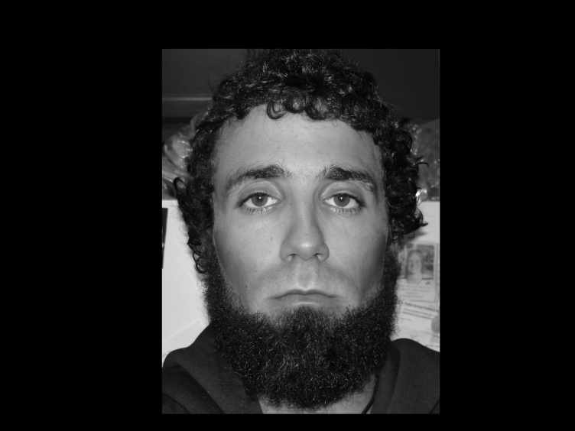
My Sociological Imagination

Slide 2
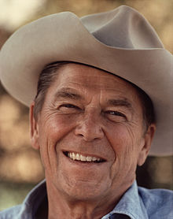
November 1980: Ronal Reagan is elected president of the United States
Establishing American Values
Highlighted Distrust of Government
Republican Icon

Slide 3
December 1980: Saudi Arabia announces it is raising its crude prices to $32
Cost of Living
Stress on Material Culture
Also stress on Non-Material Culture

Slide 4
December 1980: The prime rate advances to a record 21.5%
Stress on Lenders
Second jobs across America
Social Darwinism
Conflict theory

Slide 5
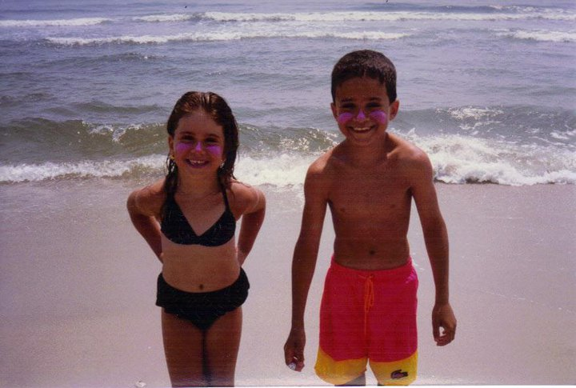
Fall of 1986: Parents divorce
Highlighted conflict
Violated social norms
Changed housing norm

Slide 6
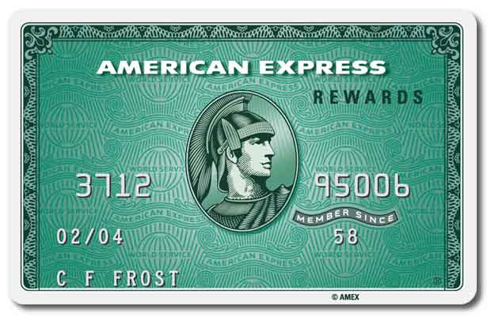
Winter 1993: Father lost Amex job
Family challenge
Value of individualism – working hard to “get
ahead”
Economic Darwinism
Conflict Theory

Slide 7
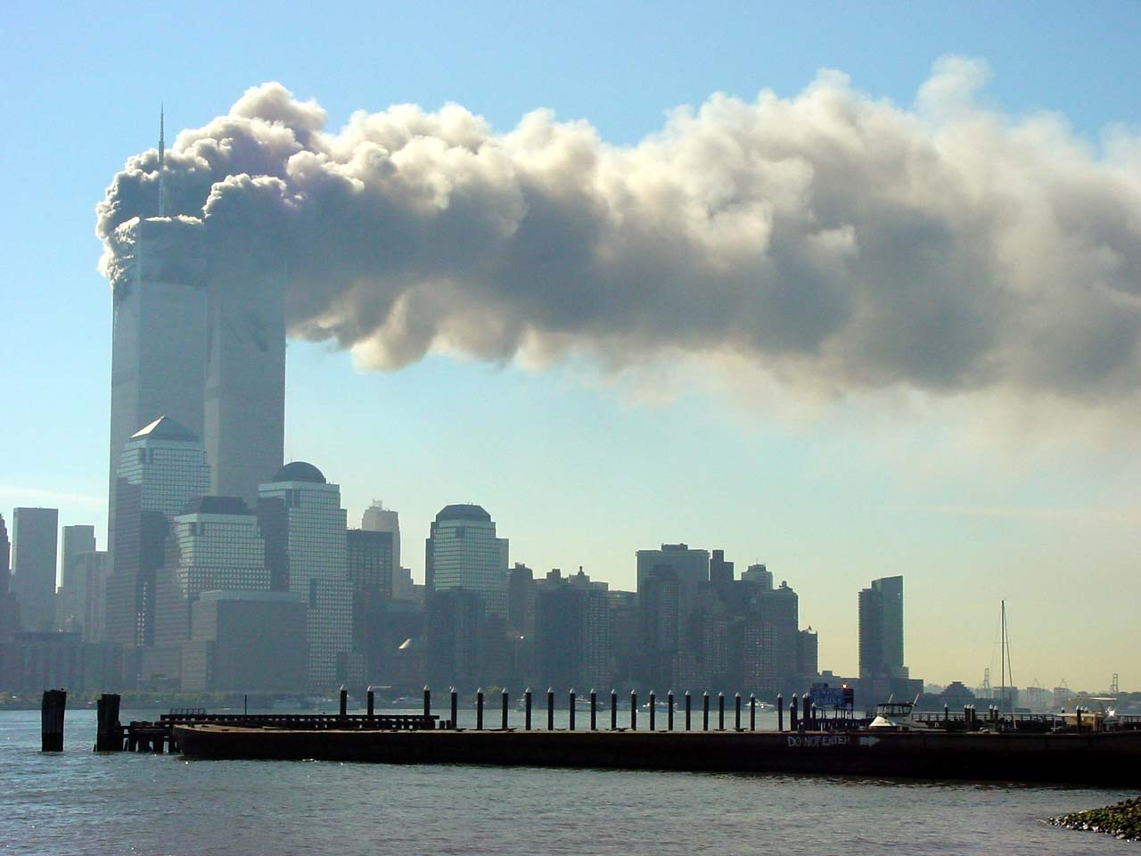
September 11, 2001: 9/11 Terror Attacks
New norms established
Ethnocentrism
Backlash at cultural diffusion
American cultural universals challenged and
galvanized in many cases.
Conflict theory
Symbols destroyed

Slide 8
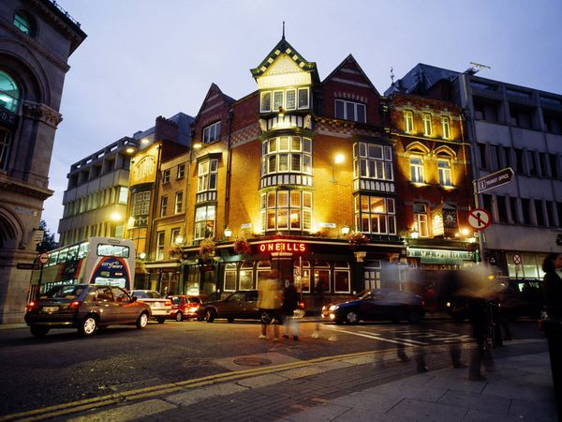
Spring Semester 2002: Study abroad in Dublin, Ireland.
Independence
Shaped World View
Learned new social
norms

Slide 9
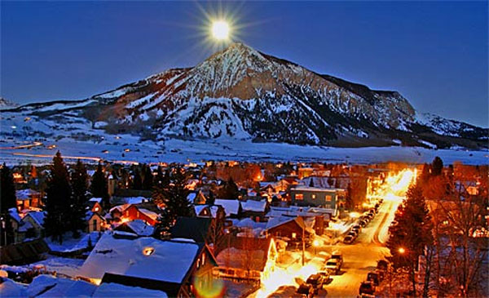
August 2005: Moved to Crested Butte, CO
Freedom
Individualism
Self-fulfillment
Narcissism
Subculture

Slide 10
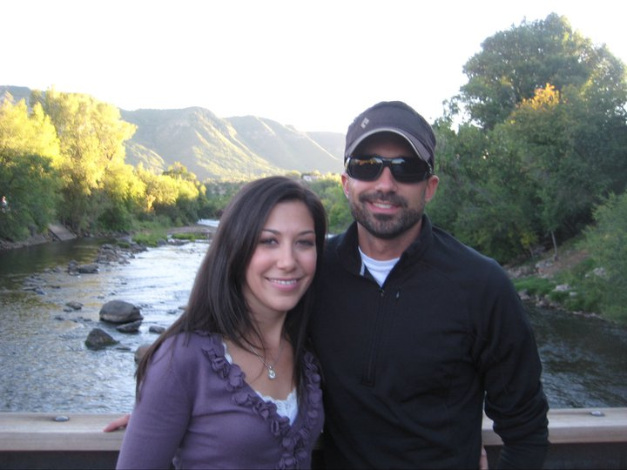
September 2013: Married to Laura
Social Darwinism
Adhering to a social norm
Functions and Dysfunctions

